Slide 1
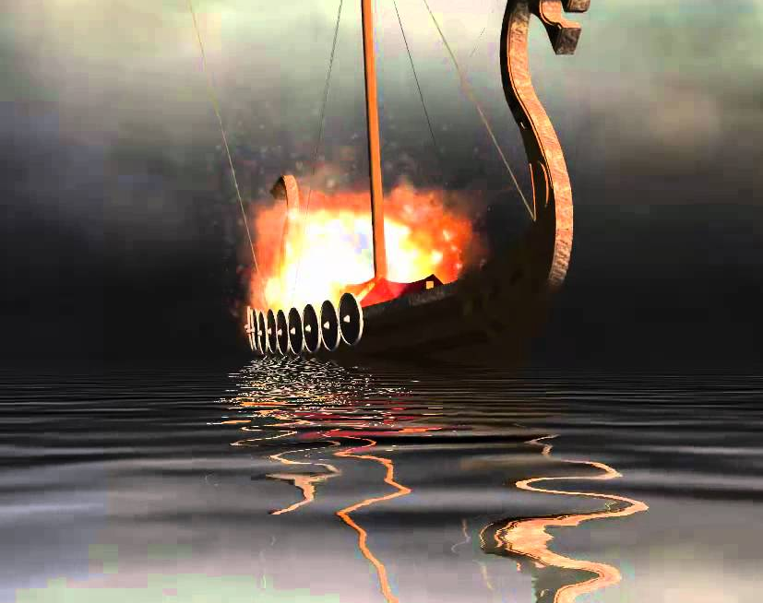
Socratic Circle
Group 1: Discuss your experiences, thoughts, feelings and questions about Taylor Mali’s narrative poem, “Tony Steinberg: Brave Seventh Grade Viking Warrior.” Avoid simply repeating another student or simply agreeing without additional analysis. Build off of each other as much as possible.
Group 2: Add any remaining comments not discussed in group 1. Then, discuss why the extended metaphor Mali chooses is both effective an appropriate to the poem. What do you feel Mali wants to communicate to his audience?

