Slide 1
Metaphors vs. Symbols
Metaphor Symbol
Can never be taken literally functions literally and figuratively
Compares 2 unlike things Represents 2 things (or more)
Lower ambiguity higher ambiguity (Open-minded!!!)
Precise imprecise
Are always nouns can be nouns and verbs (actions)

Slide 2
How do I know?
Metaphor:
Does it ever literally rain cats and dogs? No!
Is a human being literally a pig? No!
Is fame literally a bee? No!
Symbolism in the road not taken:
Can you literally choose between two different paths in a wood? YES!
Can you figuratively choose between two different paths in life? YES!

Slide 3
Function of Symbols
John green says it best:
“Symbols are important because they allow us to take something abstract and make it observable, and in doing so, It becomes more powerful.”

Slide 4
Practice with Symbols
For each of the following symbols, practice indicating the literal meaning or definition and the powerful figurative representation behind it.
Here we go…

Slide 5
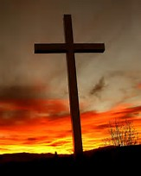
Example #1

Slide 6
Practice with Symbols
Rule #1: by presenting the same literal object in a different way, it can greatly change the symbolic meaning.

Slide 7
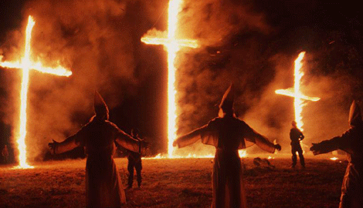
Example #2

Slide 8
Practice with Symbols
Rule #2: likewise, the same symbol can produce very contrasting feelings for different people. The ambiguity of symbols make life complicated.

Slide 9
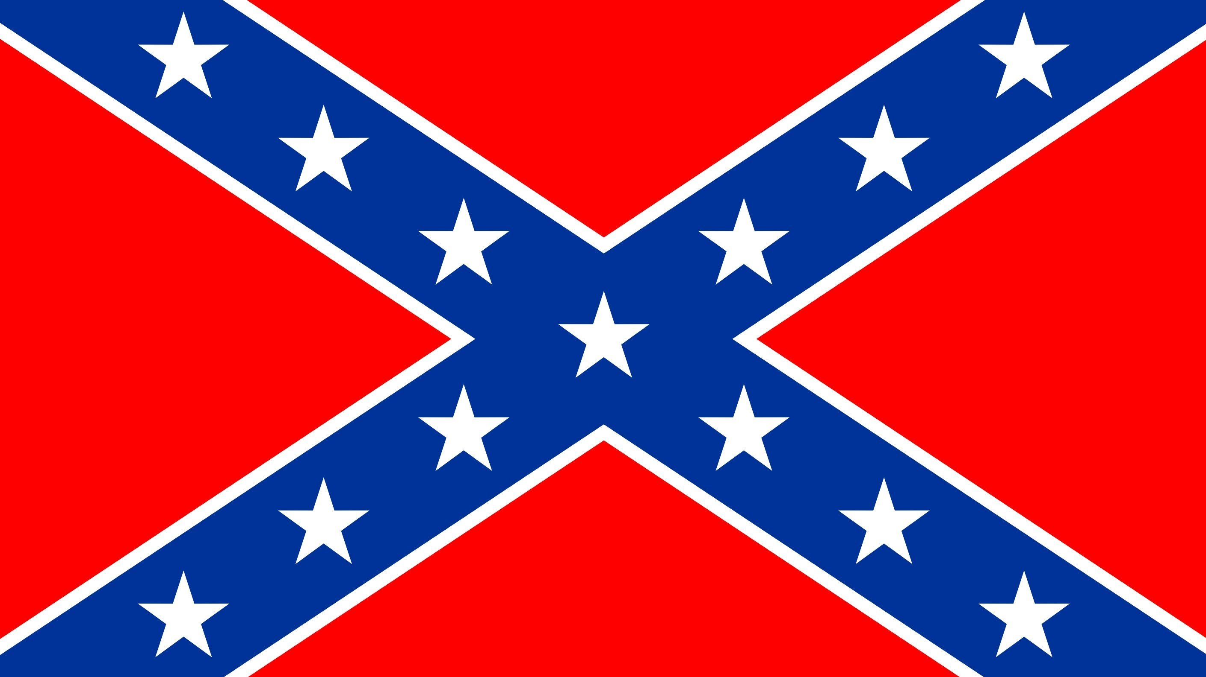
Example #3

Slide 10
Practice with Symbols
Rule #3: sometimes, a symbol generally agreed upon by one culture is seen by another very differently.

Slide 11
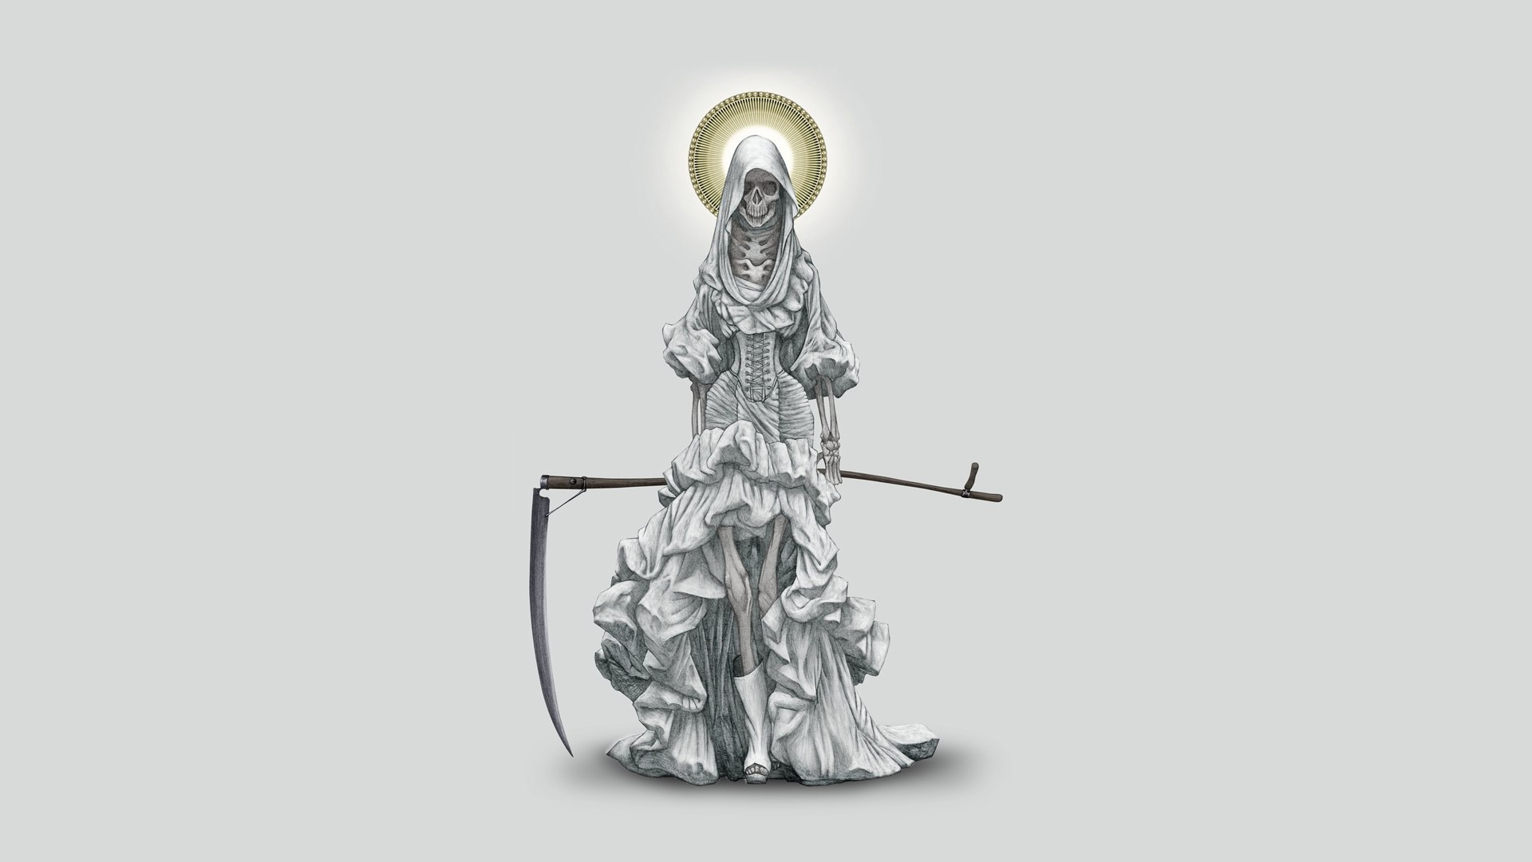
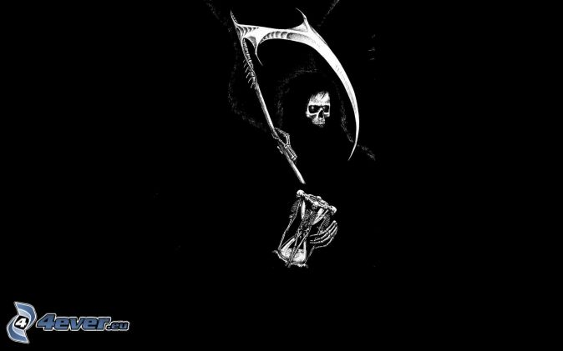
Example #4

Slide 12
Common Symbols
Keep this handy list for future reference!

Slide 13
Example #5
Let’s take a look at a scene from a well-known Disney movie and see how it functions symbolically…
https://www.youtube.com/watch?v=sEZOHy9laig

Slide 14
Example #6
Let’s take a closer look at the most prominent symbol from the movie Frozen…

Slide 15
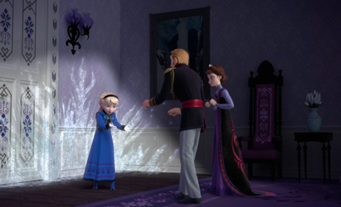
Doors as symbols

Slide 16
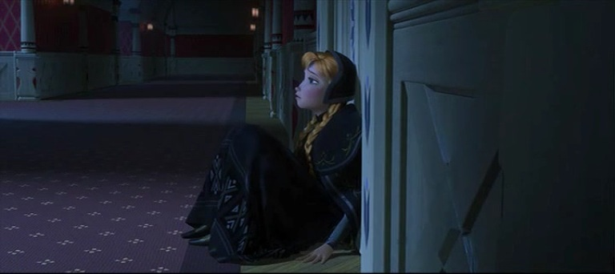
Doors as symbols

Slide 17
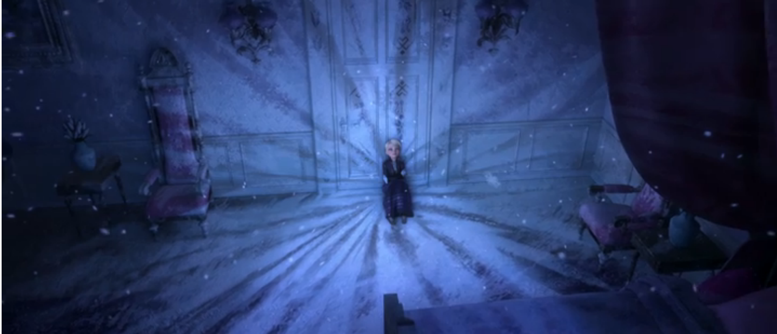
Doors as symbols

Slide 18
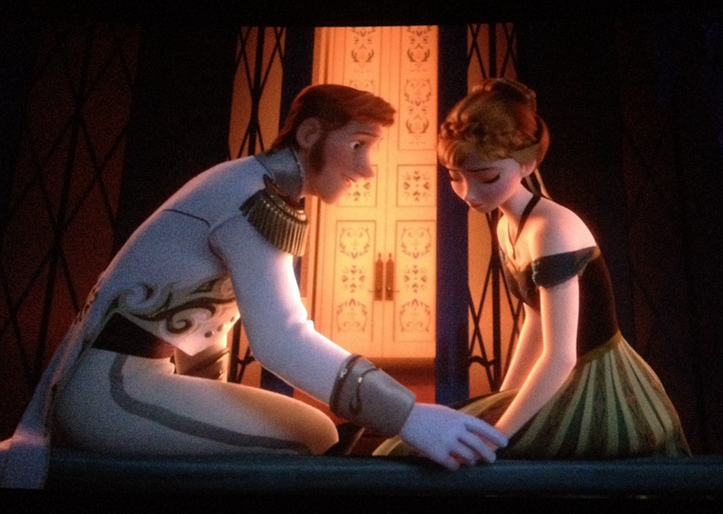
Doors as symbols

Slide 19
Doors as symbols
https://www.bing.com/videos/search?q=hans+locks+anna&&view=detail&mid=E7018701A79B464D4631E7018701A79B464D4631&rvsmid=058FCD4A583B27FD6C4C058FCD4A583B27FD6C4C&FORM=VDQVAP
Can one object (a door, for example) be used in the same work as a metaphor and as a symbol?

Slide 20
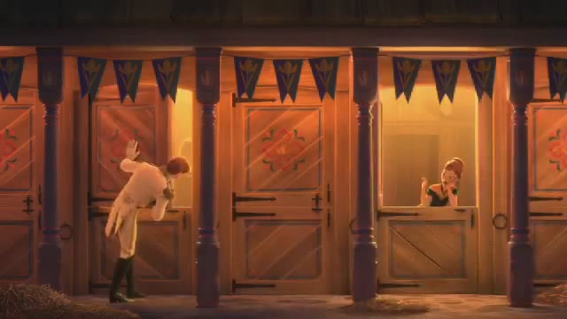
Doors as symbols

Slide 21
Function of Symbols
Paraphrasing John green:
The symbol of doors in frozen is important because they take the abstract idea of love and make the characters’ willingness to love (or not) observable. and in doing so, the theme of love in frozen becomes not only clear but also powerful.

